Slide 1
CENG 477 Introduction to Computer Graphics
Graphics Hardware and OpenGL

Slide 2
Introduction
Until now, we focused on graphic algorithms rather than hardware and implementation details
But graphics, without using specialized tools and/or hardware would simply be too slow for most applications
We will now learn about how a GPU works and how to program it using a specific API: OpenGL
The presented ideas should apply to other APIs such as Direct3D with some modifications

Slide 3
Graphics Hardware (GH)
GH is a set of components which implements the forward rendering pipeline at a chip level called GPU
Modern GPUs are programmable
GPUs are massively parallel (orders of magnitude more parallel than CPUs)
GPUs change continuously mainly due to the demands of the video game industry
Big players:
AMD, Nvidia, Intel, Microsoft, Apple, Qualcomm, …

Slide 4

Graphics Processing Unit (GPU)
How parallel are GPUs? Let’s watch this demo:

Slide 5
GPGPU
As a result of this performance, GPUs are used in many tasks that are not related to graphics at all:
Called GPGPU: General-purpose computing on GPU
Nvidia developed the CUDA language for GPGPU
OpenCL is supported by AMD, Nvidia, and Intel
Nowadays, many computational intensive tasks are performed on the GPU:
Image and video processing
Analyzing big data
Bioinformatics
Optimization
Machine learning, …

Slide 6
GPU Architecture
GPUs are similar to CPUs in their building blocks (in fact they are somewhat simpler than CPUs):
Some logic to decode the instruction to be performed
Registers
Arithmetic logic units (ALUs)
Cache
Memory
But they are massively parallel:
Data parallelism
Pipeline parallelism

Slide 7
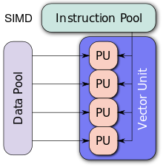
GPU Parallelism
What makes GPUs parallel?
GPUs are SIMD architectures
SIMD: Single instruction multiple data
The same instruction is applied to thousands of data elements at the same time
wikipedia.com

Slide 8
GPU Parallelism
This works well for independent tasks such as:
Transforming vertices
Computing shading for each fragment
Ideal if the task is the same but the data is different:
Data length
1 | 2 | 3 | 4 | 5 | 6 | 7 | 8 | 9 | 10
…
/2 | /2 | /2 | /2 | /2 | /2 | /2 | /2 | /2 | /2
Pipeline length
0.5 | 1 | 1.5 | 2 | 2.5 | 3 | 3.5 | 4 | 4.5 | 5
…
…

Slide 9
GPU vs CPU
GPUs have a larger number of ALUs allowing for data parallelism:

Slide 10
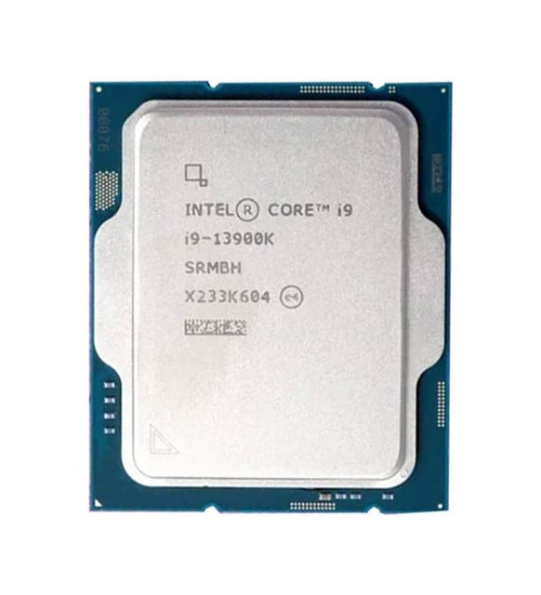
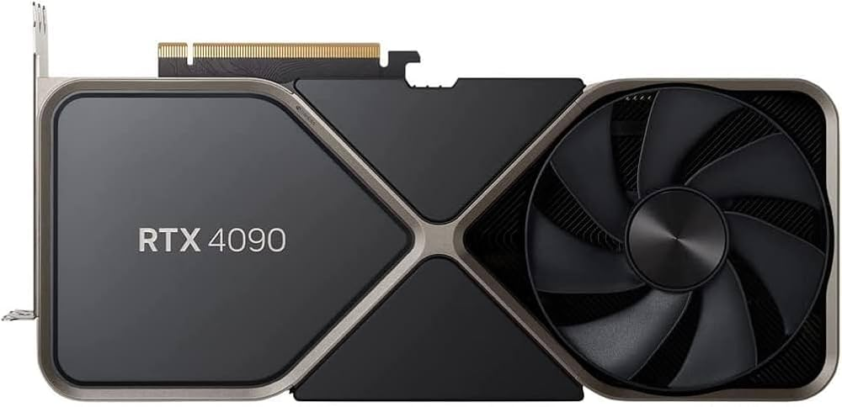
GPU vs CPU
Let’s compare a good GPU with a good CPU
Intel Core i9-13900K | Nvidia GeForce RTX 4090
Cores: 24 | Cores: 16,384
Clock: 3.0 GHz | Clock: 2.3 GHz
Power: 125W | Power: 450W
Memory BW: ~89.6 GB/s | Memory BW: ~1.01 TB/s

Slide 11
Overall GPU Architecture
Application
Application
Data Assembler
Setup / Rstr / ZCull
Vertex assembly
Vtx Thread Issue
Prim Thread Issue
Frag Thread Issue
Vertex operations
SP
SP
SP
SP
SP
SP
SP
SP
SP
SP
SP
SP
SP
SP
SP
SP
Primitive assembly
Thread Processor
Primitive operations
TF
L1
TF
L1
TF
L1
TF
L1
TF
L1
TF
L1
TF
L1
TF
L1
Rasterization
Fragment operations
L2
L2
L2
L2
L2
L2
FB
FB
FB
FB
FB
FB
Framebuffer
NVIDIA GeForce 8800
OpenGL Pipeline

Slide 12
GPU Data Flow Model
User Program
Geometry Processing
Fragment Processing
Bus
CPU
GPU
GPU
Displayed Image
Framebuffer
VGA,
DVI,
HDMI,
…
Monitor
GPU

Slide 13
User Program
The user program is an OpenGL (or Direct3D) program which itself runs on the CPU
C, C++, C#, Python, … many languages are supported
Also initially all data is in the main system memory
The user program is responsible to arbitrate the overall flow and send data to GPU:
Open a window
Manage user interaction (mouse, keyboard, etc.)
Decide what to draw and when to draw
Ask GPU to compile shaders (programs to be later run on the GPU)

Slide 14
Opening a Window
Opening a window for rendering is not part of OpenGL
Each OS has a different mechanism
There are some high-level APIs that simplify this process
GLFW is one such API
GLFWwindow* window;
if (!glfwInit())
exit(EXIT_FAILURE);
glfwWindowHint(GLFW_CONTEXT_VERSION_MAJOR, 2); glfwWindowHint(GLFW_CONTEXT_VERSION_MINOR, 1);
window = glfwCreateWindow(640, 480, "Simple example", NULL, NULL);
if (!window) {
glfwTerminate();
exit(EXIT_FAILURE);
}
glfwMakeContextCurrent(window);

Slide 15
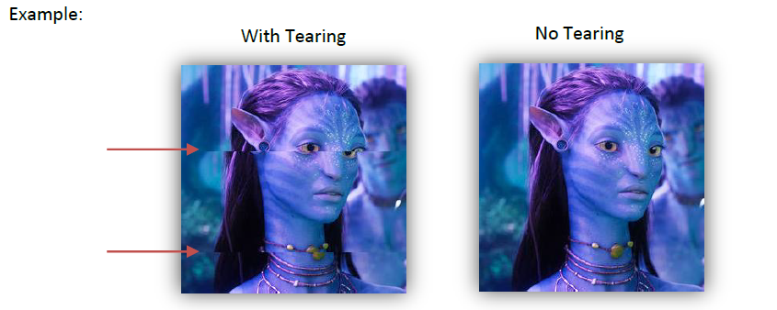
Double Buffering
By default GLFW windows are double buffered.
Double buffering avoids problems such as flickering and tearing:

Slide 16
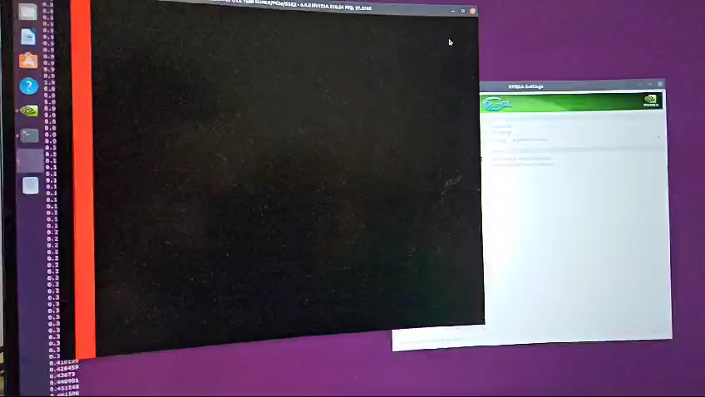
Double Buffering
Tearing

Slide 17
Double Buffering
To ensure that tearing does not occur, make sure to use the following GLFW command as well:
glwfSwapInterval(1)
The default value of the swap interval is 0, which can cause swapping of the buffers in the middle of the monitor’s refresh cycle
With glwfSwapInterval(1), it is ensured that buffer swapping occurs at the same time as the monitor is refreshed (called the vsync time)
This setting can be enforced using the driver’s settings as well (e.g. NVIDIA control panel)

Slide 18
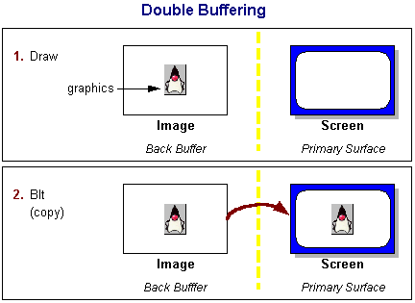
Double Buffering
In double buffereing, we render to a back buffer and show that buffer only when drawing is complete (usually synchronized with monitor’s refresh cycle)
Windowed mode requires a copy:
oracle.com

Slide 19
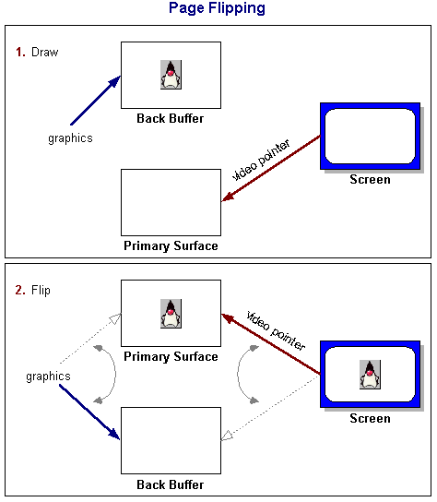
Double Buffering
In fullscreen mode, only the video pointer is flipped:
oracle.com

Slide 20
Managing User Interaction
The user may interact with the program through input devices: traditionally keyboard and mouse
GLFW also simplifies this task by registering callbacks:
glfwSetKeyCallback(window, key_callback);
glfwSetMouseButtonCallback(window, mouse_button_callback);
static void key_callback(GLFWwindow* window, int key, int scancode,
int action, int mods)
{
if (key == GLFW_KEY_ESCAPE && action == GLFW_PRESS)
glfwSetWindowShouldClose(window, GLFW_TRUE);
}
void mouse_button_callback(GLFWwindow* window, int button,
int action, int mods)
{
if (button == GLFW_MOUSE_BUTTON_RIGHT && action == GLFW_PRESS)
popup_menu();
}

Slide 21
Displaying/Resizing the Window
Whenever a window is displayed or resized, certain settings (such as the viewport) may need to be updated:
This function can also be registered by using GLFW:
glfwSetWindowSizeCallback(window, window_resized);
void window_resized(GLFWwindow* window, int width, int height)
{
// code to update viewport/projection etc.
glViewport(0, 0, width, height);
}

Slide 22
Rendering Each Frame
We first clear all buffers, then render our frame, and finally swap buffers (remember double buffering):
while (!glfwWindowShouldClose(window))
{
renderScene();
animate();
showFPS(window);
glfwSwapBuffers(window);
glfwPollEvents();
}
glfwDestroyWindow(window);
glfwTerminate();
exit(EXIT_SUCCESS);
Clearing of the framebuffer
and rendering of the scene
is performed here
We may insert any code to update the scene parameters in our rendering loop

Slide 23
GLFW
You may learn more about GLFW at:
https://www.glfw.org/docs/3.3/window_guide.html
There are some other window managers as well:
GLUT (http://freeglut.sourceforge.net/)
SDL (https://www.libsdl.org/)
General purpose GUI libraries can also be used:
E.g. wxWidgets, QT, FLTK, …
You can even use the native window managers such as X11, Cocoa, or Windows’ native library functions
In this case, your application will not be cross-platform

Slide 24
Sending Geometry Data
The user program must communicate the geometry information to the GPU
A simple approach:
We tell GPU that we want to draw a line from (x₀, y₀, z₀) to (x₁, y₁, z₁)
glBegin(GL_LINES);
glVertex3f(x0, y0, z0);
glVertex3f(x1, y1, z1);
glEnd();

Slide 25
Sending Geometry Data
Attributes besides position can be sent as well:
We tell GPU that we want to draw a line from (x₀, y₀, z₀) to (x₁, y₁, z₁)
The endpoint colors are (1, 0, 0) and (0, 1, 0)
glBegin(GL_LINES);
glColor3f(1, 0, 0); // red (note that range is in [0, 1])
glVertex3f(x0, y0, z0);
glColor3f(0, 1, 0); // green
glVertex3f(x1, y1, z1);
glEnd();

Slide 26
Sending Geometry Data
Triangles are similar:
Every group of three vertices define a triangle
Drawing two triangles:
glBegin(GL_TRIANGLES);
glVertex3f(x0, y0, z0);
glVertex3f(x1, y1, z1);
glVertex3f(x2, y2, z2);
glEnd();
glBegin(GL_TRIANGLES);
glVertex3f(x0, y0, z0); glVertex3f(x1, y1, z1); glVertex3f(x2, y2, z2);
glVertex3f(x3, y3, z3); glVertex3f(x4, y4, z4); glVertex3f(x5, y5, z5);
glEnd();

Slide 27
Sending Geometry Data
With this approach m triangles require 3m vertex calls
An improved method is to use triangle strips for meshes
The first three vertices define the first triangle
Every vertex afterwards defines a new triangle
m triangles require m+2 vertex calls
glBegin(GL_TRIANGLE_STRIP);
glVertex3f(x0, y0, z0);
glVertex3f(x1, y1, z1);
glVertex3f(x2, y2, z2);
glVertex3f(x3, y3, z3);
glEnd();
0
2
0, 1, 2
2, 1, 3
1
3

Slide 28
Winding Order
Winding order determines the facing of a triangle
Here both triangles are facing toward the viewer:
glBegin(GL_TRIANGLE_STRIP);
glVertex3f(x0, y0, z0);
glVertex3f(x1, y1, z1);
glVertex3f(x2, y2, z2);
glVertex3f(x3, y3, z3);
glEnd();
0
2
0, 1, 2
2, 1, 3
1
3

Slide 29
Winding Order
Winding order determines the facing of a triangle
Here both triangles are facing away from the viewer:
It is important to use a consisting winding order when drawing a mesh due to backface culling
glBegin(GL_TRIANGLE_STRIP);
glVertex3f(x0, y0, z0);
glVertex3f(x2, y2, z2);
glVertex3f(x1, y1, z1);
glVertex3f(x3, y3, z3);
glEnd();
0
2
0, 2, 1
1, 2, 3
1
3

Slide 30
Graphics State
OpenGL is a state machine
Various states are preserved until we change them
In the example below, the color of each vertex is set to (0, 1, 0), that is green:
glColor3f(0, 1, 0)
glBegin(GL_TRIANGLE_STRIP);
glVertex3f(x0, y0, z0);
glVertex3f(x1, y1, z1);
glVertex3f(x2, y2, z2);
glVertex3f(x3, y3, z3);
glEnd();

Slide 31
Graphics State
Below the first three vertices have the same color and normal
The fourth vertex has a different color and normal:
glColor3f(0, 1, 0)
glNormal3f(0, 0, 1)
glBegin(GL_TRIANGLE_STRIP);
glVertex3f(x0, y0, z0);
glVertex3f(x2, y2, z2);
glVertex3f(x1, y1, z1);
glColor3f(1, 0, 0)
glNormal3f(1, 0, 1)
glVertex3f(x3, y3, z3);
glEnd();

Slide 32
Sending Geometry Data
Previous examples send data in immediate mode
Immediate mode is ineffiecient: A large model would require too many glVertex calls
Each glVertex call is executed on the CPU and the corresponding data is sent to the GPU
A better approach would be to send all vertex data to the GPU using a single call
We use vertex arrays for that purpose

Slide 33
Vertex Arrays
There are several arrays such as vertex position array, vertex color array, vertex normal array, …
Below is an example of vertex position array:
You must enable an array before using it:
glVertexPointer(size, type, stride, pointer)
Pointer to vertex
position data
Number of coordinates
per vertex
Type of each
coordinate
Byte offset between
consecutive vertices
glEnableClientState(GL_VERTEX_ARRAY)

Slide 34
Vertex Arrays
In modern OpenGL, these explicit attribute names are replaced by a generic attribute array function:
Don’t forget to enable it:
glVertexAttribPointer(index, size, type, normalized, stride, pointer)
Array index
Whether integer data
should be normalized
Pointer to vertex
position data
Number of coordinates
per vertex
Type of each
coordinate
Byte offset between
consecutive vertices
glEnableVertexAttribArray(index)

Slide 35
Drawing with Vertex Arrays
We use a single draw call to draw using vertex arrays:
glDrawArrays(mode, first, count)
Primitive
type
Starting index
in the enabled
arrays
Number of indices
to be rendered

Slide 36
Drawing with Vertex Arrays
glDrawArrays may still be inefficient as vertex attribute data must be repeated for each primitive
glDrawElements is designed to solve this issue by using indices:
glDrawElements(mode, count, type, indices)
Primitive
type
Pointer to
indices
Number of indices
to be rendered
Type of
each index

Slide 37
Drawing with Vertex Arrays
When using client-side vertex arrays, the vertex attribute data is copied from the system memory (user pointer) to the GPU memory at every draw call
There is a better alternative, known as vertex buffers
glVertexPointer(size, type, stride, pointer)
……………………………
……………………………
copy at draw call
System memory
GPU memory

Slide 38
Vertex Buffer Objects
Previous methods required the data to be copied from the system memory to GPU memory at each draw
Vertex Buffer Objects (VBOs) are designed to allow this copy to take place only once
The copied data is reused at each draw

Slide 39
Vertex Buffer Objects
To use VBOs, we generate two buffers:
Vertex attribute buffer (position, color, normal, etc.)
Element array buffer (indices)
GLuint vertexAttribBuffer, indexBuffer;
glGenBuffers(1, &vertexAttribBuffer);
glGenBuffers(1, &indexBuffer);

Slide 40
Vertex Buffer Objects
Next, we bind these buffers to locations that are meaningful for the GPU:
glBindBuffer(GL_ARRAY_BUFFER, vertexAttribBuffer);
glBindBuffer(GL_ELEMENT_ARRAY_BUFFER, indexBuffer)

Slide 41
Vertex Buffer Objects
We then ask the GPU to allocate memory for us and copy our data into this memory
Attribute data size
in bytes
Attribute data pointer
glBufferData(GL_ARRAY_BUFFER, aSize, aPtr, GL_STATIC_DRAW);
glBufferData(GL_ELEMENT_ARRAY_BUFFER, iSize, iPtr, GL_STATIC_DRAW);
Index data size
in bytes
Index data pointer

Slide 42
Vertex Buffer Objects
Once this is done, the CPU data can safely be deleted:
Attribute data size
in bytes
Attribute data pointer
glBufferData(GL_ARRAY_BUFFER, aSize, aPtr, GL_STATIC_DRAW);
glBufferData(GL_ELEMENT_ARRAY_BUFFER, iSize, iPtr, GL_STATIC_DRAW);
Index data size
in bytes
Index data pointer
delete[] aPtr;
delete[] iPtr;

Slide 43
Vertex Buffer Objects
Before drawing, we can specifying an offset into our buffers
It is accomplished by the same function as before
But this time, pointer indicates a byte offset into our buffer (similar for glColorPointer, etc.)
glVertexPointer(size, type, stride, pointer)
Offset to vertex
position data
Number of coordinates
per vertex
Type of each
coordinate
Byte offset between
consecutive vertices

Slide 44
Vertex Buffer Objects
Drawing is the same as before where index pointer is now also an offset to the element array buffer:
glDrawElements(mode, count, type, indices)
Primitive
type
Offset to
indices
Number of indices
to be rendered
Type of
each index

Slide 45
Vertex Buffer Objects
The relevant buffers must still be enabled:
Unfortunately, this is a very bad naming as it suggests client-side data is being used
In modern OpenGL, these are replaced with:
glEnableClientState(GL_VERTEX_ARRAY)
glEnableClientState(GL_COLOR_ARRAY)
…
glEnableVertexAttribArray(0);
glEnableVertexAttribArray(1);
…

Slide 46
Vertex Buffer Objects
Note that in glVertexPointer and glDrawElements the last parameter is sometimes treated as pointer and sometimes offset
OpenGL makes this decision as follows:
If a non-zero name is bound to GL_ARRAY_BUFFER, the last parameter glVertexPointer is treated as offset (otherwise pointer)
If a non-zero name is bound to GL_ELEMENT_ARRAY_BUFFER, the last parameter glDrawElements is treated as offset (otherwise pointer)

Slide 47
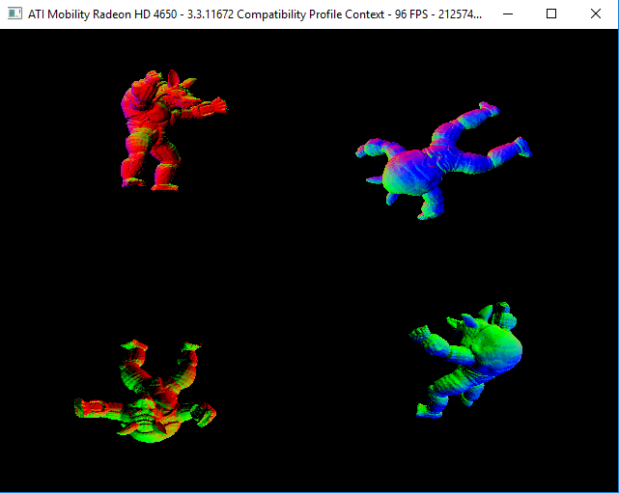
Performance Comparison
Drawing an Armadillo model comprised of 212574 triangles at four distinct locations (resulting in a total of 850296 triangles):
Notes:
Show basic_obj_draw example

Slide 48
Performance Comparison
On AMD Mobility Radeon HD4650 and at resolution 640x480:
Using VBOs the frame rate was about 100 FPS
Using client-side glDrawElements, the frame rate was about 20 FPS
Therefore, almost all modern games use VBOs for drawing complex models

Slide 49
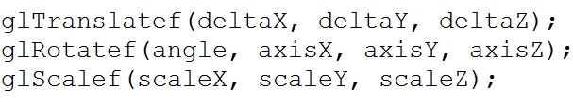
Transformations in OpenGL
In classic OpenGL, transformations are performed using three commands:
These commands update the current matrix
Therefore the current matrix should be set as GL_MODELVIEW before calling these commands
Note that angle is in degrees (not radians)!

Slide 50
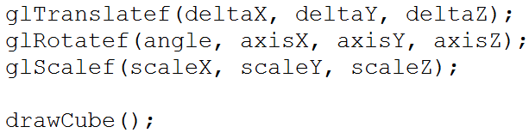
Transformations in OpenGL
Transformations apply in the reverse order
The command closest to the draw call takes effect first
Here, the cube is first scaled, then rotated, and finally translated

Slide 51
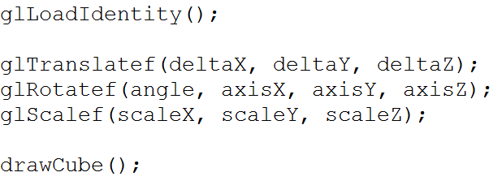
Transformations in OpenGL
Transformations keep effecting the current matrix
If you want to draw an object at the same position at each frame you need to reset the matrix to identity:
Otherwise your object will quickly disappear!

Slide 52
Transformations in OpenGL
In OpenGL, we do not specify a camera position
It is assumed that the camera is at (0, 0, 0) and looking down the negative z axis
You can view a modelview transformation in two ways:
Transform all objects drawn after the transformation by keeping the camera fixed
Transform the camera (i.e. coordinate system) by the opposite transformations by keeping the objects fixed
In reality, objects are transformed but both would produce the same result

Slide 53
Transformations in OpenGL
The following approach is in fact deprecated:
In modern OpenGL, we create the transformation matrix and send it to the “vertex shader” as a “uniform variable”
GLM library is commonly used for this purpose

Slide 54

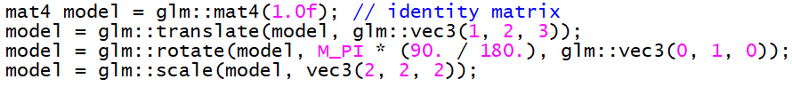
Transformations in OpenGL
Include the GLM headers
Specify the transformation
Send your matrix to the GPU (more on this later)
…
Angle is in radians
In the shader, when applied on a vertex, v, you will get:
v’ = T * R * S * v

Slide 55
Summary
OpenGL is a cross-platform API for rendering 3D graphics
Many language bindings
Today, modern OpenGL API is fully hardware accelerated
GLFW is a cross-platform library for window management
User interaction with keyboard, mouse also part of it
GLM is a header only library for transformations
This is CPU only
The computed matrix is uploaded to GPU by the user
The idea is minimize CPU usage and maximize GPU utilization for high performance graphics

